Slide 1

Development Policy and Politics
Structures of Capital Accumulation in Mozambique
Carlos Nuno Castel-Branco
(cnbranco@iseg.ulisboa.pt | carlos.castelbranco@gmail.com)
PhD in Development Studies
Academic Year 2023-2024

Slide 2
Structure of the presentation
Introduction – summary of an argument based on historical research
Key characteristics of the Mozambican economy:
  Patterns of specialization
  Dependency on inflows of large scale private foreign capital
  Public debt and financialization
  Speculative financial system reflecting structures of accumulation
  Inequality and poverty
How did we come to this? How to analyse it? This is for the next lectures

Slide 3
Introduction – summary of an argument based on historical research
Key characteristics of the Mozambican system of capital accumulation, which result from the combination of the structures of capitalism inherited from colonialism and the developing of a national, capitalist bourgeoisie, which, for historical reasons arises dependent upon the State and inflows of foreign capital.
By the end of the 1980s, the formation of the national, capitalist bourgeoisie, from of the ashes of the post-independence State-centred project of accumulation, became the central political battle driving State policy.
  The WC demands, against a background of humanitarian crises, failure of state centred project, withdrawal of the state from active policy (except monetary monetarist policy and austerity), internationalization of post-apartheid South African capital, a weak, emerging capitalist class, and collapsing structures of the labour movement. What emerged as the Mozambican capitalist mode of accumulation is largely the result of the specific class structured conditions articulated by the combination of linkages (such as the pattern of specialization and globalization of South African capital) and agencies (such as the policies and policy goals, the intervening agents).

Slide 4
Introduction – summary of an argument based on historical research
To develop a national bourgeoisie that could be unleashed, the State cannibalised itself, through what we call waves of State expropriation: privatization of SOE; denationalization and privatization of strategic natural resources, such as minerals, energy reserves, land, forestry; privatization of the State’s debt space and, in so doing, socializing the costs of private capital accumulation and financializing the State; and austerity.
Argument:
  The new Mozambican capitalist bourgeoisie emerged from the reproduction and expansion of the patterns, linkages and structures of accumulation inherited from colonialism, due to the dependency of the national bourgeoisie on foreign inflows of private capital,
  Such dependence articulated and focused State policies,
  The combination of these linkages and agencies inevitably aggravated the tendency, frequency and depth of the economic instability and crises

Slide 5
Key characteristics

Slide 6
Pattern of specialization

Slide 7
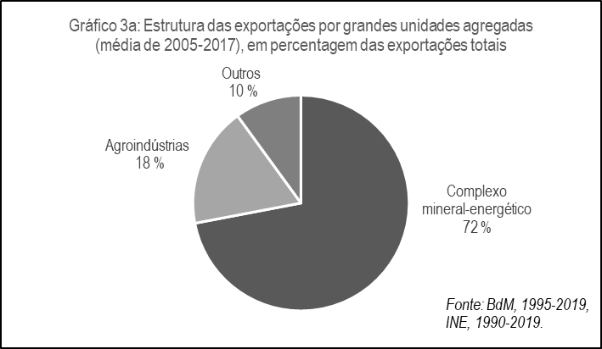
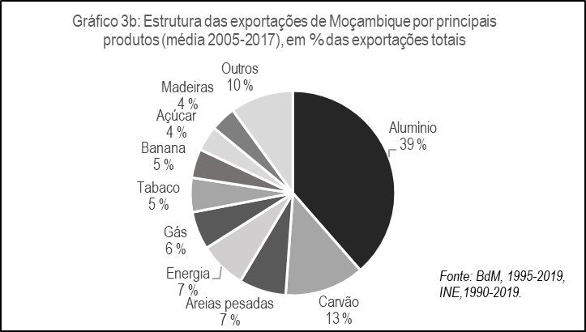
Pattern of specialization

Slide 8
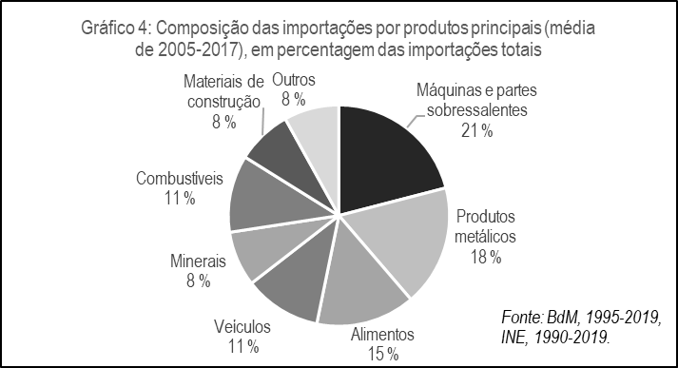
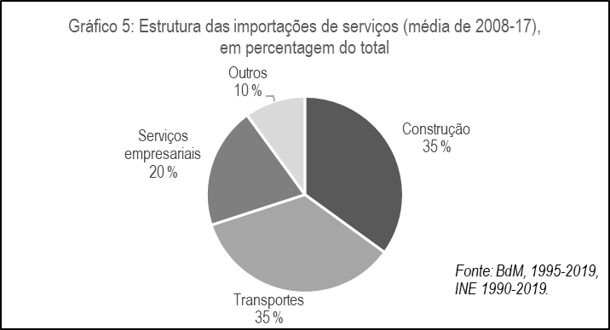
Pattern of specialization

Slide 9
Growth rates of GDP and of selected main sectors of the economy, 2005-2019
 | GDP | Extractive industries | Financial services | Construction | Trade and maintenance of vehicles | Transports, storage, communication | Energy and Water | Agriculture and Forestry | Industry
 |  |  |  |  |  |  |  |  | Including aluminium and gas | Excluding aluminium and gas
Annual average rate of growth | 7.4% | 23% | 16% | 11% | 10% | 6% | 6% | 3.2% | 4.3% | 2.5%
Cumulative growth | 172% | 1714% | 699% | 331% | 280% | 126% | 126% | 55% | 80% | 41%
Ratio of sector do GDP cumulative growth | 1 | 10 | 4 | 1.9 | 1.6 | 0.73 | 0.73 | 0.32 | 0.47 | 0.24
Source: BoM (1995-2000, 2000); INE (1990-2019)

Slide 10
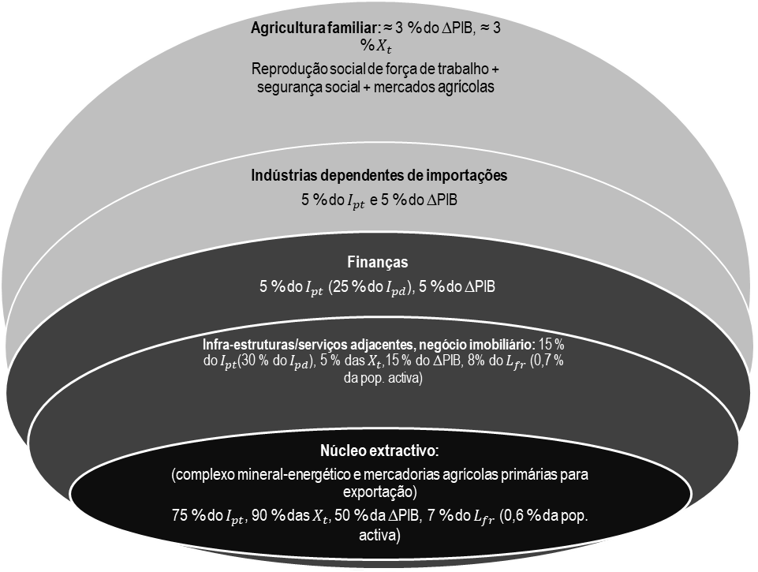
Pattern of specialization

Slide 14
Dependency on private foreign capital

Slide 15
Dependency on private foreign capital

Slide 16
Debt and financialization of the state

Slide 17
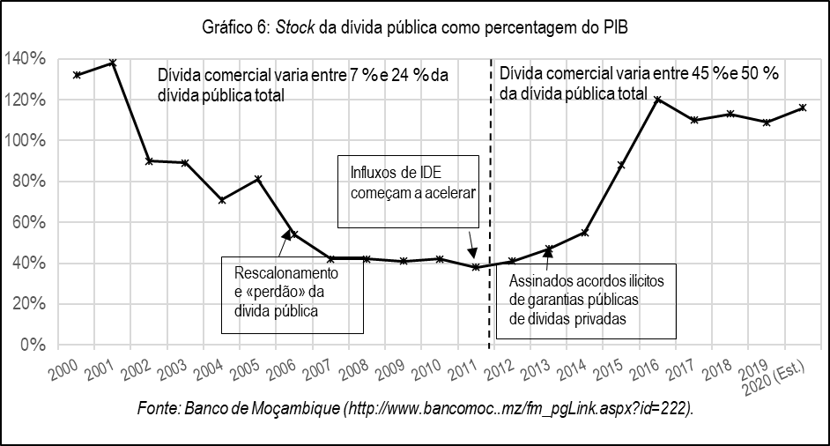
Debt and financialization of the state

Slide 18
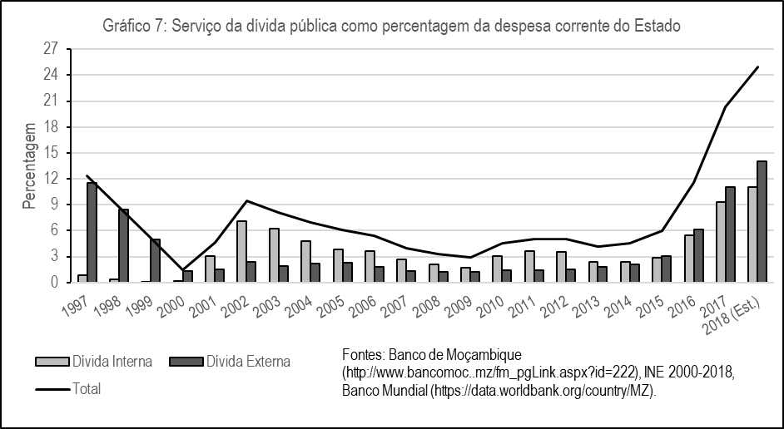
Debt and financialization of the state

Slide 19
Debt and financialization of the state
 | Variação do stock de dívida pública |  |  | Taxa de crescimento do PIB | Crescimento da componente comercial da dívida pública |  |  | Alocação da dívida commercial por tipo de despesa (% da dívida comercial total)
 | Interna | Externa | Total |  | Variação do stock | Peso na dívida pública total em 2006 | Peso na dívida pública total em 2019 | Infra-estruturas da economia extractiva | Garantias públicas de dívida privada e PPPs | Pagamento do serviço da dívida
Crescimento acumulado entre 2006-2019 (em %) | 1 017 % | 390 % | 515 % | 130% | 4 990 % | 8 % | 49 % | 31% | 39% | 30%
Variação média anual (em %) | 26 % | 13 % | 15 % | 6,6% | 37 % | - | - | - | - | -

Slide 20
Dependency and financialization
PCD
Riversdale

Slide 21
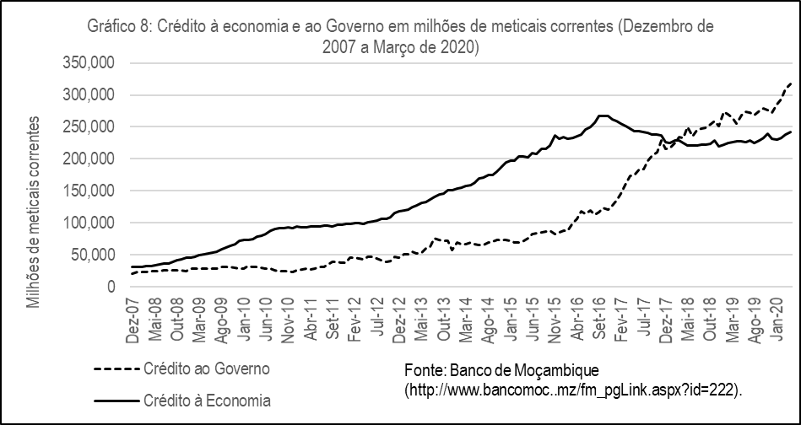
Speculative financial sector

Slide 22
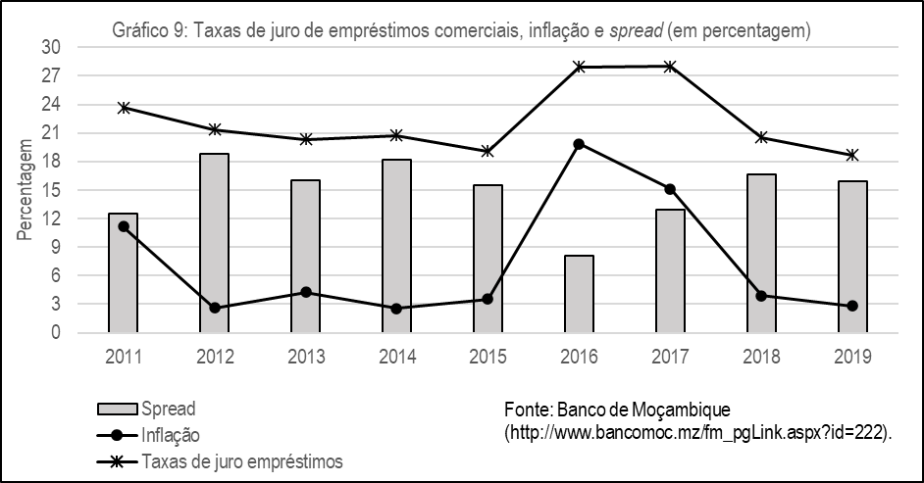
Speculative financial sector

Slide 23
Speculative financial sector

Slide 24
Speculative financial sector

Slide 25
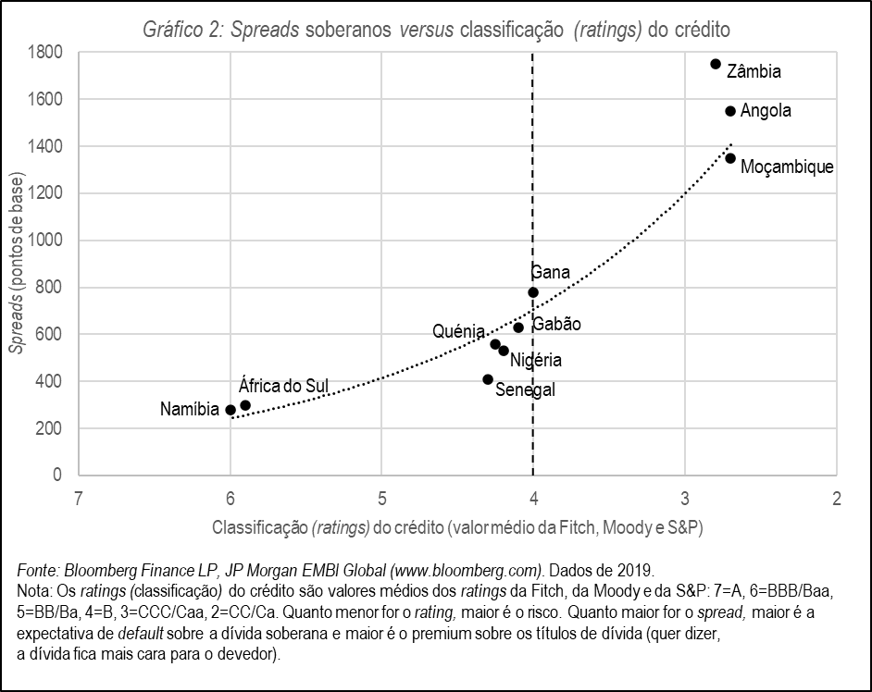
Speculative financial sector

Slide 26
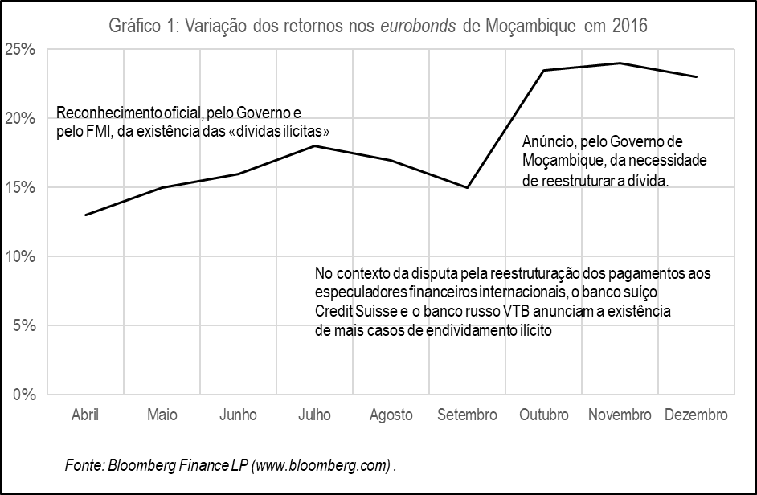
Speculative financial sector

Slide 27
Social inequality and poverty
General Data:
  Gini: from 0.47 to 0.54
  Income shares: poorer 60% declined from 28% to 23%; Highest 10% increased from 40% to 50%
  Number of poor increased by two million and number of millionaires doubled, multimillionares increased 5x, and um centi-millionaire
  Income elasticity of poverty is -0.11, and declines as growth accelerates

Slide 28
Social inequality and poverty
Social inequality, wealth concentration and the resilience of poverty result from the same objective economic and social dynamics, the mode of accumulation in Mozambique.
  The dynamics of inequality and poverty minimise the options for linkage-based import-substitution and for production of basic wage goods for the domestic market and consolidate the patterns of production oriented for exports of primary goods.
  On the other hand, as salaries and other remunerations do not pay for the social costs of labour reproduction, productivity outside of the extractive economy tends to be low and absenteeism high, as workers need to multiply and diversify their sources of income

Slide 29
References/Recommended Additional Readings
https://www.researchgate.net/publication/319554499_Contribuicao_para_o_metodo_de_investigacao_da_economia_politica_de_Mocambique
https://www.researchgate.net/publication/319554822_Logica_Historica_do_Modelo_de_Acumulacao_de_Capital_em_Mocambique
https://www.researchgate.net/publication/305730467_DILEMAS_DA_INDUSTRIALIZACAO_NUM_CONTEXTO_EXTRACTIVO_DE_ACUMULACAO_DE_CAPITAL
https://www.researchgate.net/publication/284720099_Economic_linkages_between_Mozambique_and_South_Africa
https://www.researchgate.net/publication/284720139_Industria_e_industrializacao_em_Mocambique_analise_da_situacao_actual_e_linhas_estrategicas_de_desenvolvimento_I_Quaderni_della_Cooperazione_Italiana_32003
https://www.researchgate.net/publication/273340949_Growth_capital_accumulation_and_economic_porosity_in_Mozambique_social_losses_private_gains
https://www.researchgate.net/publication/284720288_Capitalizando_O_Capitalismo_Domestico_-_Porosidade_e_Acumulacao_Primitiva_de_Capital_em_Mocambique

Slide 30
References/Recommended Additional Readings
hthttps://www.researchgate.net/publication/284720256_REFLECTINDO_SOBRE_ACUMULACAO_POROSIDADE_E_INDUSTRIALIZACAO_EM_CONTEXTO_DE_ECONOMIA_EXTRACTIVA
https://www.researchgate.net/publication/284720903_Economia_extractiva_e_desafios_de_industrializacao_em_Mocambique
https://www.researchgate.net/publication/284720995_Opcoes_Economicas_de_Mocambique_1975-95_Problemas_Licoes_e_Ideias_Alternativas
https://www.researchgate.net/publication/319617910_Crises_Economicas_e_Estruturas_de_Acumulacao_de_Capital_em_Mocambique

Slide 31
References/Recommended Additional Readings
https://www.researchgate.net/publication/284720475_Desafios_da_Sustentabilidade_do_Crescimento_Economico_uma_Bolha_Economica_em_Mocambique
https://www.researchgate.net/publication/297255681_Crises_ciclicas_e_desafios_de_transformacao_do_padrao_de_crescimento_economico_em_Mocambique
https://www.researchgate.net/publication/303672732_Introducao_a_problematica_da_divida_publica_contextualizacao_e_questoes_imediatas
https://www.researchgate.net/publication/303750489_A_DIVIDA_SECRETA_MOCAMBICANA_IMPACTO_SOBRE_A_ESTRUTURA_DA_DIVIDA_E_CONSEQUENCIAS_ECONOMICAS
https://www.researchgate.net/publication/303818853_Rebatendo_Mitos_do_Debate_sobre_a_Divida_Publica_em_Mocambique
https://www.researchgate.net/publication/303864588_Cenarios_Opcoes_Dilemas_de_Politica_face_a_Ruptura_da_Bolha_Economica
https://www.researchgate.net/publication/303943946_Cronica_de_uma_crise_anunciada_divida_publica_no_contexto_da_economia_extractiva
http://www.iese.ac.mz/wp-content/uploads/2017/04/5des2016_FM.pdf

Slide 32
References/Recommended Additional Readings
https://www.researchgate.net/publication/319554303_Desafios_para_Mocambique_2017
https://www.researchgate.net/publication/284720995_Opcoes_Economicas_de_Mocambique_1975-95_Problemas_Licoes_e_Ideias_Alternativas (In Brazão Mazula (organizador). 1995. Moçambique – eleições, democracia e desenvolvimento)
https://www.researchgate.net/publication/284721218_Problemas_Estruturais_do_Desenvolvimento_Agrario (In Carlos Castel-Branco (organizador). 1994. Moçambique – Perspectivas Económicas)
https://www.researchgate.net/publication/284721216_Problemas_estruturais_de_industrializacao_a_industria_transformadora (In Carlos Castel-Branco (organizador). 1994. Moçambique – Perspectivas Económicas)
https://www.researchgate.net/publication/286457576_An_Investigation_Into_the_Political_Economy_of_Industrial_Policy_the_Case_of_Mozambique_Chapter_Three (In PhD Thesis: Carlos Castel-Branco. 2002. An Investigation Into the Political Economy of Industrial Policy: the Case of Mozambique, Chapter 3)

